Slide 1

Medha Bisht 2017341
Yogesh Thakur 2017397
Aryamann Singh 2017313
Divyam Kholia 2017324
Under the Guidance of
Dr. Durga Prasad Gangodkar
Professor, Department of Computer Science & Engineering
Project Team ID: MP23CE004
A Framework for Fall Detection Using Audio and Video Features

Slide 2
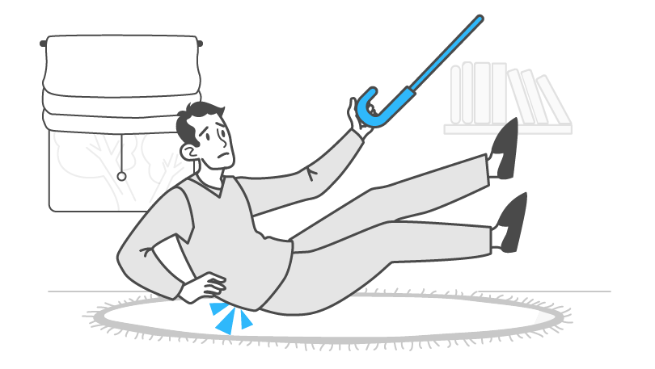
Problem Statement :-
Falls can lead to severe injuries, diminished quality of life, and, in unfortunate cases, even fatal consequences. As the elderly population grows worldwide, there is a demand for better surveillance systems, specifically fall detection systems to tackle this issue. A fall detection system based on vision, that can automatically monitor and detect falls, recognize distress calls from the injured and send out help messages to local emergency numbers for timely medical care. When the system identifies a potential fall and determines distress through audio cues, it automatically triggers a call for help.

Slide 3
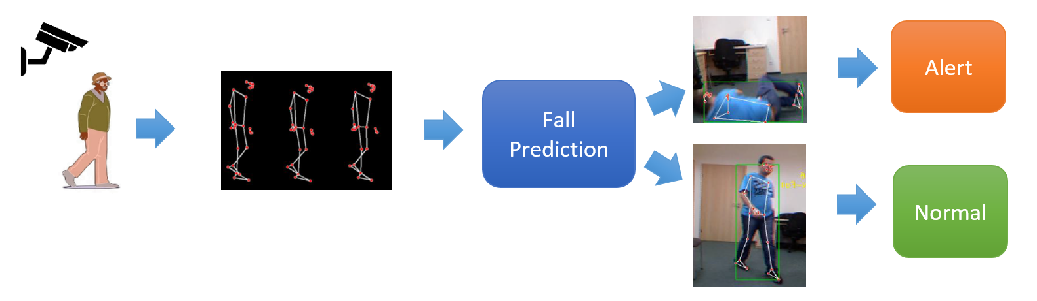
Introduction :-
We recognize the serious impact of falls, causing injuries to fatalities, especially with a growing elderly population. In response, there's a strong need for improved surveillance, particularly advanced fall detection systems. Our vision is a system using vision-based technology to automatically monitor and detect falls. It goes beyond detection, identifying distress calls from the injured.

Slide 4

Literature survey :-
Machine learning and deep learning techniques have played a pivotal role in the development of fall detection frameworks, with various classifiers and neural network architectures being explored. Researchers commonly employ datasets specifically curated for fall detection studies, using standard evaluation metrics to assess the performance of their models.
Real-world applications showcase the practical implementation of these frameworks, highlighting their potential impact in diverse settings. Challenges, including false positives/negatives, scalability, and robustness, have been acknowledged and addressed in the literature.

Slide 5
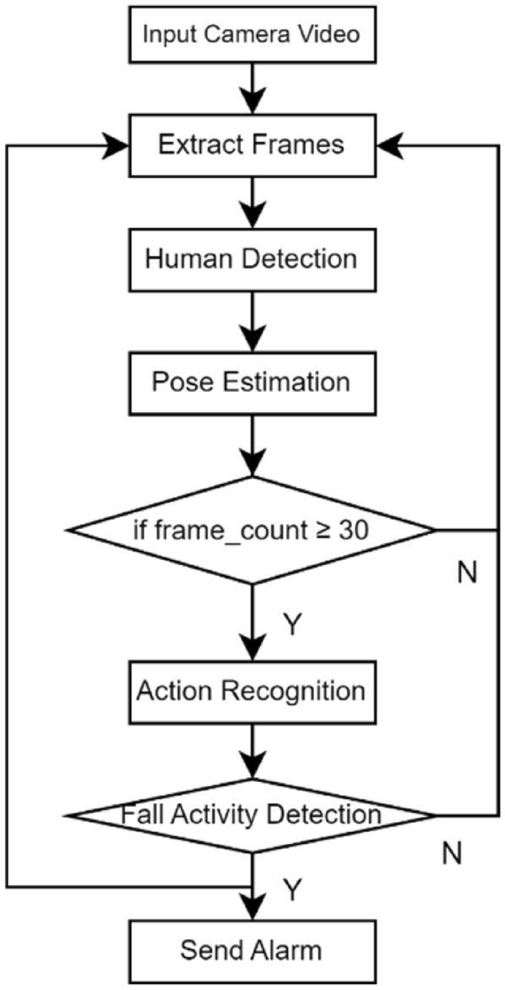
Objective :-
1.Detect fall in complex situation: To accurately detect falls on the basis of the video and live time camera feed, even in challenging environments.
2.Distress Call: To accurately detect falls on the basis of the distress call made by the person during or after the fall for help, even in noisy environment.
3.Fast Response: To minimize the delay between the occurrence of a fall and the system's detection for emergency situations.
4.Removal of False alarm: To minimize the number of false alarms, which can be caused by other activities, such as sitting down or lying down.
5.Real-Time Assistance: To provide alerts quickly so that help can be provided to the person who has fallen as soon as possible.
6.User Assistance: To Provide additional information about the fall, such as potential injuries, to assist caregivers and medical professionals.

Slide 6
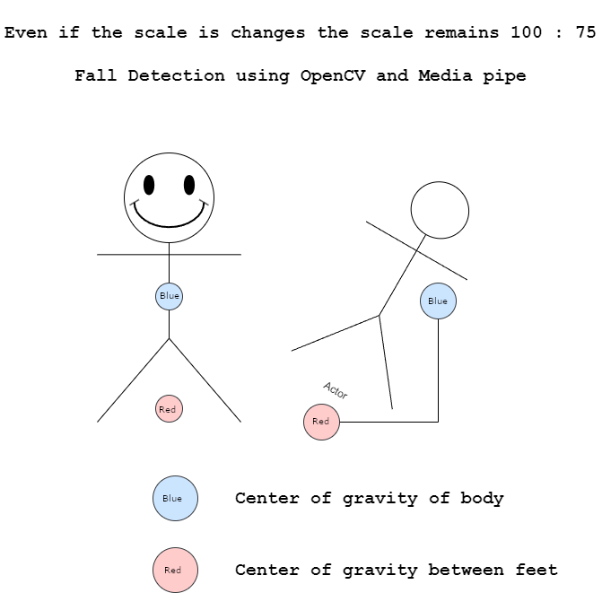
Project work carried out
1. Initialization:
•Capture video stream: OpenCV captures video from a camera.
•Media Pipe setup: Media Pipe's Holistic model is loaded for pose estimation.
2. Frame Processing:
•Frame reading: Each frame is read from the video stream.
•Pose estimation: Media Pipe analyses the frame and generates 3D key points representing the body's pose.
3. Fall Detection Logic:
•Feature analysis: The extracted features are compared to predefined thresholds for fall detection.
•Temporal analysis: Features are analysed over multiple frames to differentiate sudden changes from regular movements.

Slide 7
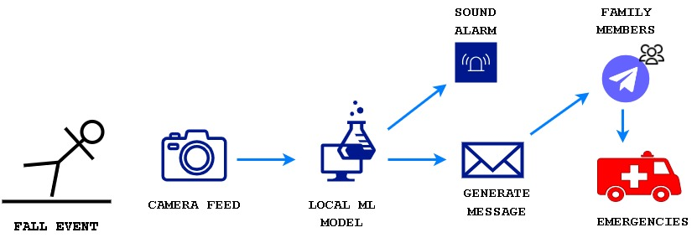
Project work carried out
Here's a simplified breakdown of the workflow:
1. Video frame captured.
2. Pose estimated with Media Pipe.
3. Key point data extracted.
4. Relevant features calculated.
5. Features compared to fall detection thresholds.
6. Temporal analysis performed.
7. Fall confirmed based on features and sequence.
8. Alert triggered, and appropriate action taken.
Tools used:
•Media Pipe – For pose estimation
•Opencv – For using videos/images as input

Slide 8
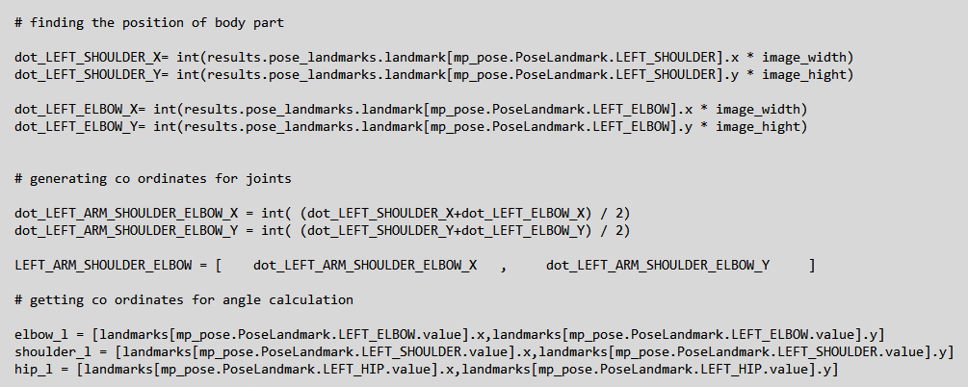
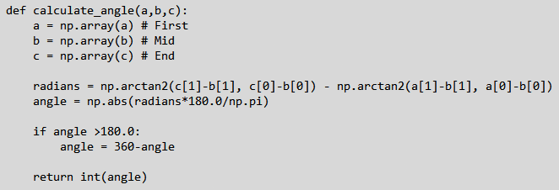
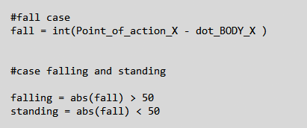
Project work carried out
Extracting Landmarks
Using the media pipe landmark function, we extracted the landmarks for different body parts of a human in the feed. The coordinates for different joints are calculated in different manner the different manners are displayed in the images below.
Calculating Angles
Using the landmarks extracted from the last step we calculate the angles between different joints of human body. The method is displayed in images below.
Detecting Fall
To detect the fall, we subtract the value of x coordinate of base (point of action) with the x coordinate of the center of mass/gravity of the body and then if it meets certain conditions then it is considered as a fall else the person is considered as standing. The conditions are in the image below.

Slide 9

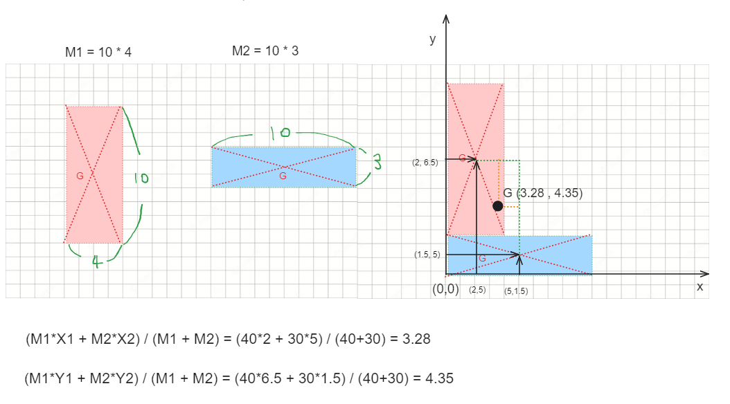
Project work carried out
Algorithm Used:
The model uses media pipe by google to detect and find all the landmarks for all the major parts of the body and later using these coordinates finds the base of the human in the feed and the center of mass of that human for upper, lower and full body and then if the center of mass of the body goes out from the base of the human body, then it considers it as a fall.
So, measuring the fall for human body will work like as follow:
Human’s Body center of mass * 0.75 > | x-axis center of feet – x-axis center of mass of body|
Formula to calculate rectangle’s center of gravity

Slide 10
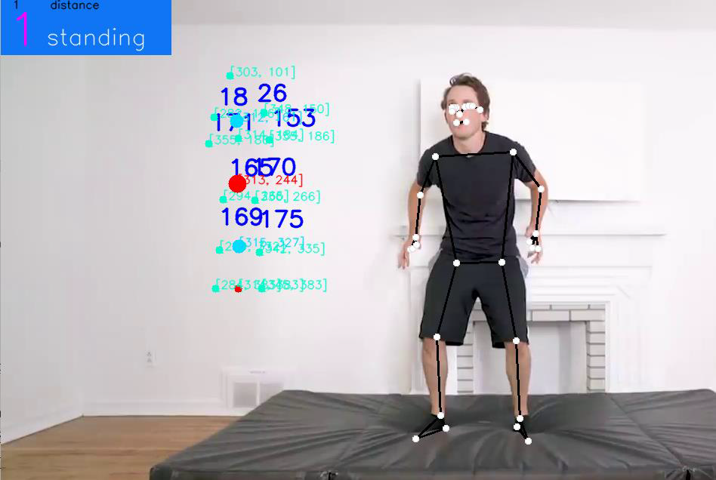
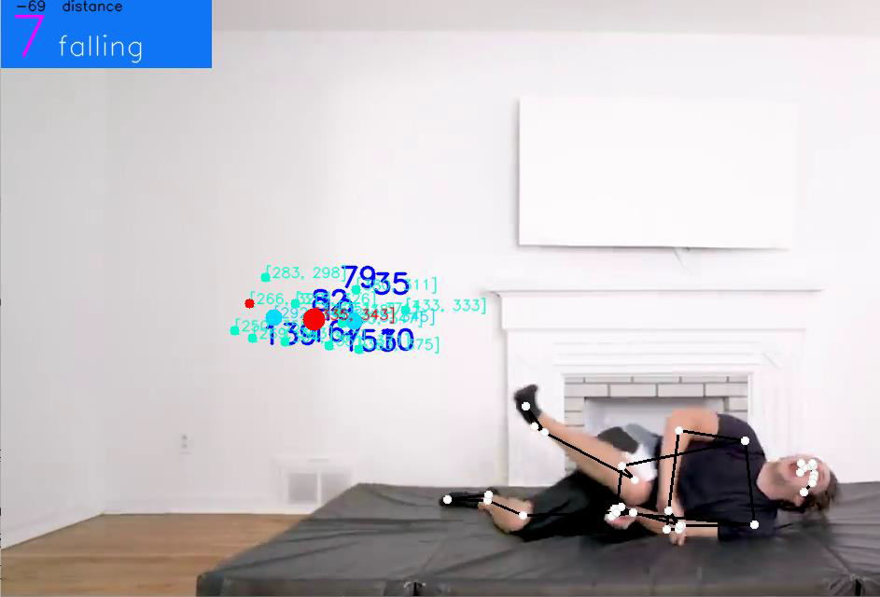
Results :-
•Standing:
•Fallen:

Slide 11
Future Work Plan
Sl. No. | Work Description | Duration in Days
1 | We plan to generate alerts to send a notification or any other type of alert whenever a fall is detected. It can be done by using teleport library of python. | 7 – 10 days
2 | We plan to integrate audio features into our fall detection framework. The addition of audio-based analysis aims to provide complementary information to enhance the overall effectiveness of fall detection. | 10 – 14 days
3 | We plan to reduce the false calls as much as possible for better use and making this model as convenient as possible | 5 – 7 days

Slide 12

Thank you !

